Slide 1
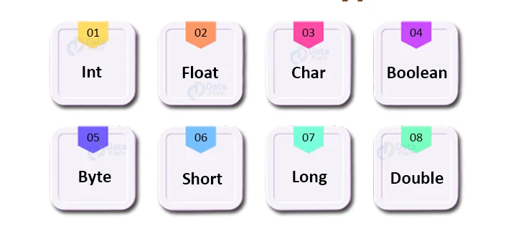
Data types
Data types

Slide 2

Data type
-The most common classification of data based on the type of value it holds.
Int i=10;
-Need almost languages
- Defines the operations(can be performed on that data ,the meaning of the data and the way it is stored in memory.)

Slide 3
Common Data types
Boolean
represent logic (true, false)
bool
Integer
represent whole numbers
int
String
represent sequence of character
string
character
represent alphabet letters(single characters)
char
Floating point
represent fractional numbers
Float ,double

Slide 4
operations
&
calculations
Data validation
optimizing codes
memory allocation
data types

Slide 5
Memory allocation
Different data types require different amount of memory to store
By specifying data types, computer can allocate appropriate amount of memory to store data
Assigning blocks of memory to processes in a computer's memory space.
When a program needs to store data, it requests a certain amount of memory from the operating system.

Slide 6
Operations & calculations
Different data types can be used for different types of operations and calculations.
For Example , numeric data types can be performed arithmetic operations like addition and subtraction.
While string data types can be used for text manipulations.

Slide 7
Data validation
Data types help data validation.
For Example ,if you try to store a string in a numeric data types, you will get an error (Int greet=“Hello!”;)
only valid data types is stored in variable or field.

Slide 8
Optimizing code
Data types can also help optimizing code by reducing the amount of time to perform operation.
For Example , using a integer data types for a loop counter can be much faster than using a floating point data types.

Slide 9

Importance of data types
-Different languages have different data types and some languages have more or fewer data types
-Data types is fundamental to writing code(efficient,
Effective ,reliable)
-Data types are used to (the correct data type ) in operation or function, to avoid error and improve performance.
-Data types enable data to store ,manipulate, and process data in a way (appropriate given task)

Slide 10

Thank you

